Slide 1
Processes and operating systems
Telephone answering machine.
© 2008 Wayne Wolf
Overheads for Computers as Components 2nd ed.

Slide 2
Theory of operation
Compress audio using adaptive differential pulse code modulation (ADPCM).
analog
time
ADPCM
3
2
1
-1
-2
-3
time
© 2008 Wayne Wolf
Overheads for Computers as Components 2nd ed.

Slide 3
ADPCM coding
Coded in a small alphabet with positive and negative values.
  {-3,-2,-1,1,2,3}
Minimize error between predicted value and actual signal value.
© 2008 Wayne Wolf
Overheads for Computers as Components 2nd ed.

Slide 4
ADPCM compression system
Σ
quantizer
inverse
quantizer
integrator
encoder
samples
inverse
quantizer
integrator
decoder
© 2008 Wayne Wolf
Overheads for Computers as Components 2nd ed.

Slide 5
Telephone system terms
Subscriber line: line to phone.
Central office: telephone switching system.
Off-hook: phone active.
On-hook: phone inactive.
© 2008 Wayne Wolf
Overheads for Computers as Components 2nd ed.

Slide 6
Real and simulated subscriber line
Real subscriber line:
  90V RMS ringing signal;
  companded analog signals;
  lightning protection, etc.
Simulated subscriber line:
  microphone input;
  speaker output;
  switches for ring, off-hook, etc.
© 2008 Wayne Wolf
Overheads for Computers as Components 2nd ed.

Slide 7
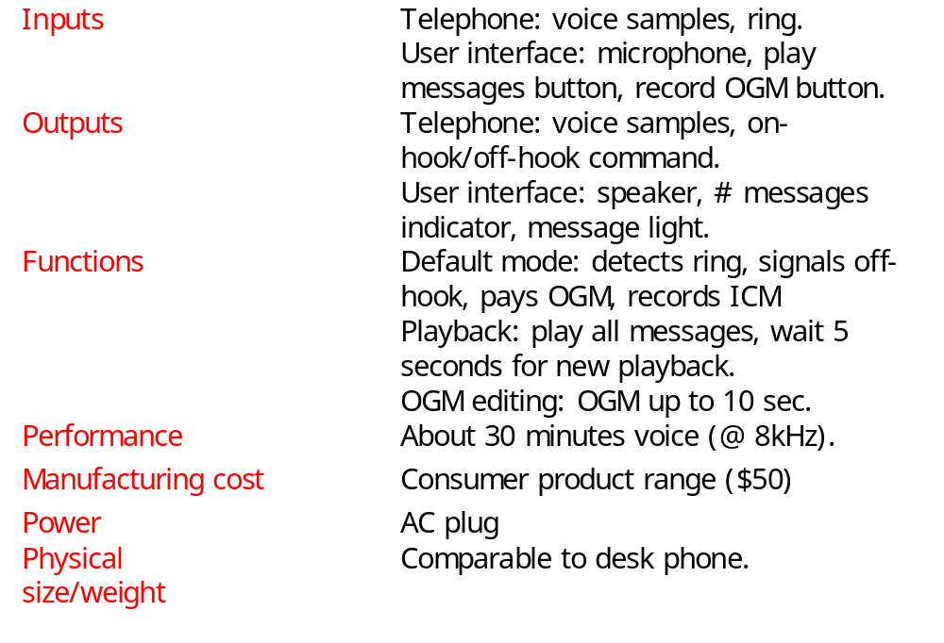
Requirements
© 2008 Wayne Wolf
Overheads for Computers as Components 2nd ed.

Slide 8
Comments on analysis
DRAM requirement influenced by DRAM price.
Details of user interface protocol could be tested on a PC-based prototype.
© 2008 Wayne Wolf
Overheads for Computers as Components 2nd ed.

Slide 9
Answering machine class diagram
1
1
1
Microphone*
1
Controls
Record
*
Outgoing-
message
1
1
1
1
1
1
Line-in*
*
1
*
1
1
Playback
Incoming-
message
Line-out*
*
1
1
Lights
Buttons*
1
Speaker*
1
© 2008 Wayne Wolf
Overheads for Computers as Components 2nd ed.

Slide 10
Physical interface classes
Microphone*
Line-in*
Line-out*
sample()
sample()
ring-indicator()
sample()
pick-up()
Buttons*
Lights*
Speaker*
record-OGM
play
messages
num-messages
sample()
© 2008 Wayne Wolf
Overheads for Computers as Components 2nd ed.

Slide 11
Message classes
Message
length
start-adrs
next-msg
samples
Incoming-message
Outgoing-message
msg-time
length=30 sec
© 2008 Wayne Wolf
Overheads for Computers as Components 2nd ed.

Slide 12
Operational classes
Controls
Record
Playback
operate()
record-msg()
playback-msg()
© 2008 Wayne Wolf
Overheads for Computers as Components 2nd ed.

Slide 13
Software components
Front panel module.
Speaker module.
Telephone line module.
Telephone input and output modules.
Compression module.
Decompression module.
© 2008 Wayne Wolf
Overheads for Computers as Components 2nd ed.

Slide 14
Controls activate behavior
Compute buttons, line activations
Activations?
Play OGM
Record OGM
Play ICM
Erase
Answer
Play OGM
Wait for timeout
Allocate ICM
Erase
Record ICM
© 2008 Wayne Wolf
Overheads for Computers as Components 2nd ed.

Slide 15
Record-msg/playback-msg behaviors
nextadrs = 0
nextadrs = 0
msg.samples[nextadrs] =
sample(source)
speaker.samples() =
msg.samples[nextadrs];
nextadrs++
F
F
End(source)
nextadrs=msg.length
T
T
record-msg
playback-msg
© 2008 Wayne Wolf
Overheads for Computers as Components 2nd ed.

Slide 16
Hardware platform
CPU.
Memory.
Front panel.
2 A/Ds:
  subscriber line, microphone.
2 D/A:
  subscriber line, speaker.
© 2008 Wayne Wolf
Overheads for Computers as Components 2nd ed.

Slide 17
Component design and testing
Must test performance as well as testing.
  Compression time shouldn’t dominate other tasks.
Test for error conditions:
  memory overflow;
  try to delete empty message set, etc.
© 2008 Wayne Wolf
Overheads for Computers as Components 2nd ed.

Slide 18
System integration and testing
Can test partial integration on host platform; full testing requires integration on target platform.
Simulate phone line for tests:
  it’s legal;
  easier to produce test conditions.
© 2008 Wayne Wolf
Overheads for Computers as Components 2nd ed.

